Slide 1

AWS COMPUTE COMPONENTS
Version: 1.0
Date: 12-11-2019
Notes:
1
1

Slide 2
SERVICES IN AWS
Compute
Storage
Database
Migration and Transfer
Networking and Content Delivery
Developer Tools
Customer Enablement
Robotics
Blockchain
Satellite
Quantum Technologies
Management and Governance
Media Services
Machine Learning
Analytics
Security, Identity and Compliance
AWS Cost Management
Mobile
AR & VR
Application Integration
Customer Engagement
Business Application
End User Computing
Internet of Things
Game Development
Notes:
2
2

Slide 3
COMPUTE SERVICE
Compute
EC2
2. Lightsail
3. ECS
4. EKS
5. Lambda
6. Elastic Beanstalk
6. AWS Outposts
6. EC2 Image Builder
Notes:
3
3

Slide 4
EC2 - ELASTIC COMPUTE CLOUD
Amazon EC2 is a service which helps the developer sin provisioning VMs in cloud
AMI – Amazon Machine Image - An Amazon Machine Image (AMI) provides the information required to launch an instance.
HVM – Hardware Virtual Machine - instance that mimics bare-metal server setup which provides better hardware isolation. With this instance type, the OS can run directly on top of the Virtual Machine without additional configuration making it to look like it is running on a real physical server.
EBS – Elastic Block Storage – It is a high performance block storage service mainly used for high throughput and transaction intensive workloads.
Instance type - They have varying combinations of CPU, memory, storage, and networking capacity, and give you the flexibility to choose the appropriate mix of resources for your applications.
Security Groups - A security group acts as a virtual firewall for your instance to control inbound and outbound traffic.
Notes:
4
4

Slide 5
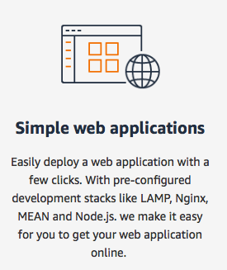
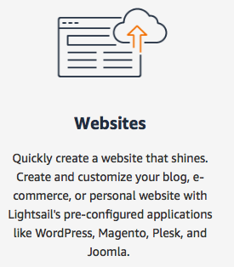
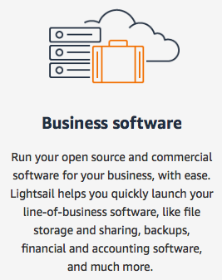
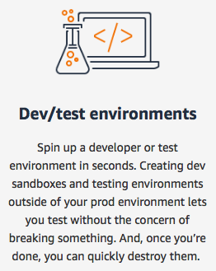
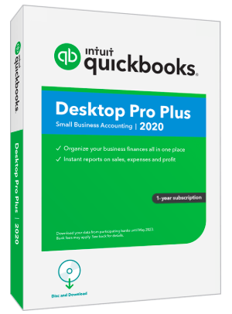



LIGHTSAIL
Lightsail is an easy-to-use cloud platform that offers you everything needed to build an application or website. Lightsail is ideal for simple workloads, quick developments. We can choose the instance image and select the application that needs to be preinstalled in the instance.
We can create the test enviroments like as we do in selenium and erase it when the task is done.
MAMP, WAMP
Wordpress
Cerebrus FTP server
Notes:
5
5

Slide 6


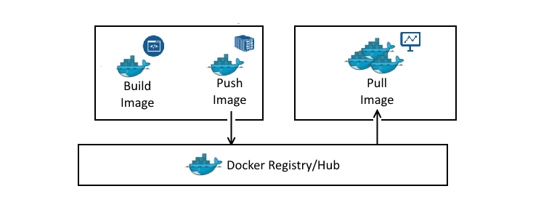
ECS – ELASTIC CONTAINER SERVICE
Amazon Elastic Container Service (Amazon ECS) is a fully managed container orchestration service. Container Images like Docker Images can be loaded to the containers as an application to serve the clients.
Load image to container
It deploys, manage, and scale Docker containers running applications, services. Amazon ECS places containers across your cluster based on your resource needs and is integrated with ELB, EC2 security groups, EBS volumes and IAM roles.
Docker Images
Docker Container
Container definition – we choose the image for the container. We can provide the name for the container, Port mappings, etc.
Task definition – This is the blueprint for the application. We can mention the Task Definition Name, Container name, We can select the instance, VPC, IAM rules, CPU allocation, memory allocation, PORT, etc.
Prebuilt docker images
ECR – Elastic Container Registry – We can store and manage docker images.
Then we care the service where we can select the loadbalancer for routing the traffic to multiple customers. Here we use Application Load balancer. Once the service is created we can select the cluster on which the service needs to be run, we can mention the VPC ID and subnets.
Notes:
6
6

Slide 7
EKS – ELASTIC KUBERNETES SERVICE
Also known as K8s. It is an orchestration software built by google team, currently maintained by CNF – Cloud Native Computing Foundation.
Control Plane
- Contains Controllers, Kubescheduler, ETCD DB, CC manager
Data Plane
- Contains multiple EC2 instances
Control Plane
Data Plane
Contains Controllers
Kubescheduler
Database ETCD
Cloud Controller Manager
A
P
I
EC2 -1
kubelets
EC2 -2
kubelets
EC2 -3
kubelets
Pod – It is similar to Task definition in ECS, we can configure the replica section and mention the count of container needed to provide the service.
Notes:
7
7

Slide 8



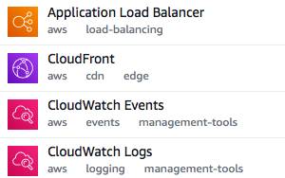
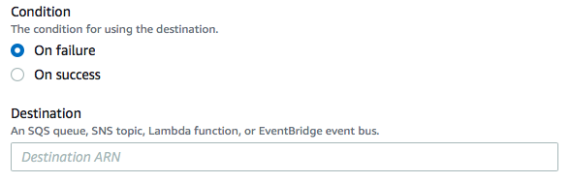
LAMBDA
It is an event driven, serverless computing platform. It is a service that runs code in response t the events triggered and automatically manages the computing resources required by that code.
AWS Lambda lets you run code without provisioning or managing servers.
Regarding the usage and payment, amazon charges based on the compute time we consume.
Functions – snippets of code that perform any task. We can type in the function based on the application or language that we are using. We can name the function.
We can choose an IAM role that defines the permissions of your function, based on that we can execute the functions with adequate permissions.
Amazon Resource Names
Notes:
8
8

Slide 9
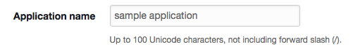
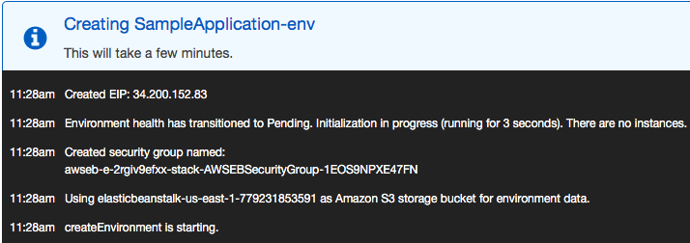
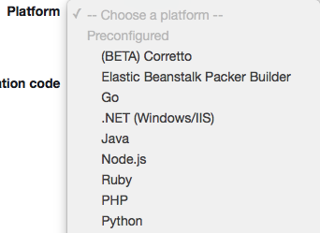
ELASTIC BEANSTALK
AWS Elastic Beanstalk is an easy-to-use service for deploying and scaling web applications and services developed with Java, .NET, PHP, Node.js, Python, Ruby, Go, and Docker.
We just have to simply upload the code and Elastic Beanstalk automatically handles and manages the deployment, provisioning, load-balancing, autoscaling.
Features - Fast and simple to begin
- Impossible to outgrow
- Complete resource control
Step-1
Step-2
Step-3
Select the platform
Upload the application,
Ex – web application
Run it
Here, the environment builds up, then a container is provisioned, a security group is created, health status is reported, etc.
Notes:
9
9

Slide 10
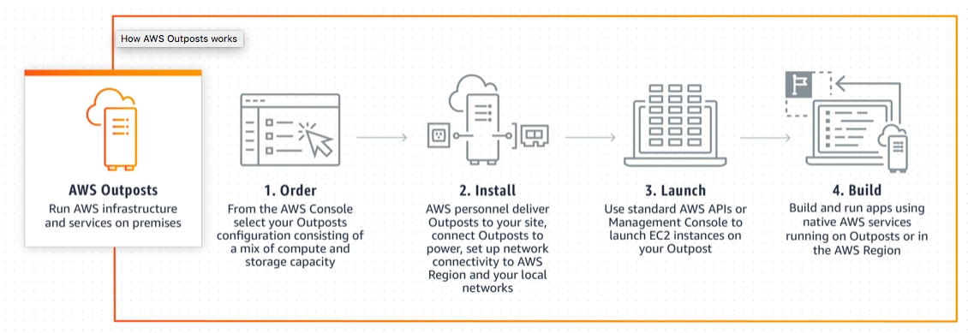
AWS OUTPOST
AWS Outposts is a fully managed service that extends AWS infrastructure. AWS Outposts is ideal for workloads that require low latency access local data processing, or local data storage.
Features – Run AWS premises on premises.
- Store and process data on premises.
- Fully managed infrastructure.
These are physical machines that needs to be ordered and will be delivered by an AWS personnel, Plugin to the socket to power it up. Once booted, we can launch EC2 instances the same way we do in AWS, APIs available, build and run the applications.
Notes:
10
10

Slide 11
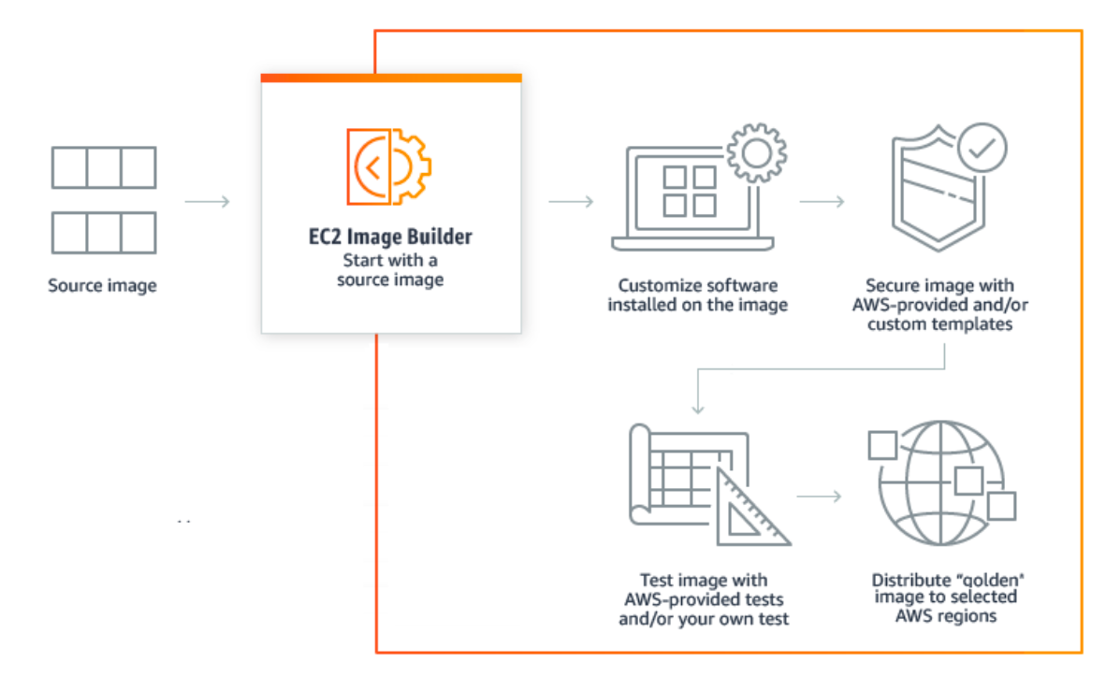
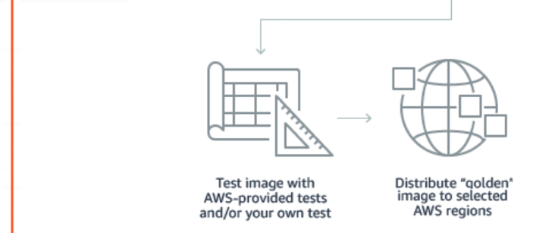
EC2 IMAGE BUILDER
EC2 Image Builder simplifies the creation, maintenance, validation, sharing, and deployment of Linux or Windows Server images for use with Amazon EC2 and on-premises.
Features – Improve productivity.
- have up to date images.
- Do not have to rely on Aws default Images.
- Built-in support for validation.
RECIPE
Select the type of OS, select the image provided by AWS.
Select the build components, ex – python, php, docker, powershell, etc.
Select the source image via the GUI. Select the dependency software, secure the images with the templates provided by AWS. Test the customized image with our own testcases or we can used the predefined test cases provided by AWS. Once the customized image passes all the tests, then the image is ready to use and can be deployed in an EC2 instance.
Notes:
11
11

Slide 12
THE END
Notes:
12
12

